Slide 1

Clarity Platform
January 2025

Slide 2
Vision, Goals and the Team for the Clarity Platform
Introduction to the Clarity Platform
Roadmap
Clarity Platform Roadmap
Effective Prompting Techniques
Demo of Clarity
Questions
Agenda

Slide 3
To encourage experimentation and learning, Yale should begin by providing equitable access to a leading, multimodal generative AI tool to all members of the Yale community. We recommend that Yale procure or develop access to a generative AI tool that will keep individual and university data private. This is such a rapidly changing space that attention must be given to flexibility over even short periods of time. The university might consider making more than one tool available to Yale faculty, staff, and students or offering flexibility in what tools are made available for use.
Report of the Yale Task Force on Artificial Intelligence

Slide 4
Goals for the Yale Clarity Platform
Address the need for equitable access to generative AI tools.
Provide a platform that is flexible enough to bring in new models and tools as they evolve.
Notes:
Specifically, the goals is to address the need for equitable access to generative AI tools and to provide a platform that is flexible enough to bring in new AI models and tools as they evolve

Slide 5
Sponsor
Jenny Frederick
The Team
Advisory Committee
Jenny Frederick, Connie Steel, Frank Mathew, Pilar Abuin, Alfred Guy, Gary Leydon, Luciano Floridi, John Coleman, Lauren Di Monte, Kaylea Nelson, Charles Barnett, Vin Guerrero, Rob Sanderson, Hadar Call, Mike Vaughn
Project Team
Mike Vaughn, Anne Pedersen, Emma Jamieson, Skip Davis, Andrew Leonard, Hadar Call
Project Partners from Across Yale IT
Steve Wieda, Jason Ignatius, Kay Ratanasaka, Vin Guerrero, Colby Laracuente, John Baldo, Alan Scrimenti, Prateek Kapoor, Dominic Machado, Dan Hofstatter, Netal Patel, Chris Lago and many others…
Vendors Partners
Solliance, UnitedMinds, Microsoft, More to come…

Slide 6
Introduction to the Clarity Platform
Clarity is a secure, general-purpose AI chatbot that is freely available to Yale's staff, students, and faculty.
Clarity was launched on August 28, 2024, in response to the recommendations of the Yale Task Force on Artificial Intelligence.
The available models in the Clarity Platform includes ChatGPT-4o and ChatGPT-4o Mini.
Clarity is a secure platform that safeguards sensitive information and ensure your data is not contributing to external AI model development.
Notes:
The Clarity platform is addressing the goal of equitable access by allowing students, faculty, and staff to use and experiment with Clarity for free.
In its first phase (will later get to what the next phases of the platform will offer), the Clarity platform offers an AI chatbot.
This AI chatbot is a general purpose chatbot which essential means that it has not been trained on Yale data.
The second goal is to accommodate several AI models also known as LLMs. Went live with ChatGPT-4o and as of late December the platform also offers the ChatGPT-4o mini model.
You might ask how is Clarity different from some of the public AI tools such as OpenAI’s ChatGPT?
1) Interactions are securely stored within Yale’s IT infrastructure and you can put low, medium and high risk data into Clarity with the exception of Electronic Protected Health Information (ePHI) data.
2) No limits on the number of chats and usage.
3) Accessible platform that adheres to Yale’s accessibility standards.
4) And as mentioned it is free to use.

Slide 7
Clarity Platform Security
Yale’s Clarity AI platform has been reviewed for use by the Yale Information Security Office, in consultation with the Yale Clarity team and our vendors, Solliance and Microsoft. Clarity is appropriate for use with low, medium and most high-risk data, with the notable exception of Electronic Protected Health Information (ePHI). In addition to not using Clarity with ePHI, users with external obligations affecting their data, such as data use agreements, should make sure their use of Clarity is appropriate. NIST 800-171 data is an example of data with an external obligation that cannot be used in Clarity.
For information on Yale’s data classification process, including specific examples, see: Data Classification Guidelines on Yale’s Information Security Website: https://cybersecurity.yale.edu/data-classification

Slide 8
Roadmap
August
Clarity Platform is Live!
October
Image Creation with DALL-E 3
File Uploads via OneDrive
Response streaming
November
Accessibility improvements
Customization such as agent welcome message
December
Foundational work to manage custom bots and APIs
GPT-4o Mini is available as a new agent
January
Claude Sonnet 3.5
Enhanced printing functionality of conversations
Foundational work to manage custom bots and APIs
Q1-2025
OpenAI GPT-o1 - limited availability
Text to speech
Google Gemini 1.5 Pro
Broad release of custom bot creation and API access

Slide 9

Generative AI use cases
Developing documents.
Sparking creativity for both strategic and tactical thinking.
The generation of extremely specific and customized royalty-free art.
Generate and review code.
Summarization of long and/or complex documents.
Create presentations.
… and much more!
A vertically-oriented portrait of an English bulldog looking like a programmer sitting in front of a computer with the computer screen displaying code snippets
Notes:
Generative AI refers to a subset of artificial intelligence technologies that can generate new content, data, or information that is similar but not identical to the original training data. Generative AI models are designed to understand and learn the patterns, structures, and features of the data they are trained on to produce new items that resemble the original data.
This enables use cases such as developing documents, create presentations, generate code, create images – as you will see in this presentation most of the images have been generated using Generative AI.

Slide 10
Using Generative AI Safely & Securely
Free and public Generative AI tools are not private
Do not share personal or professional sensitive or identifiable information.
Generative AI models will hallucinate
Most generative AI models can and will produce factually wrong or outdated information. Always fact-check to confirm the accuracy of the outputs generated.
Generative AI models are biased
Bias can be created from the training data or may emerge within the model itself.
Generative AI tools are not a substitute for professional advice
Don’t rely on the outputs from generative AI models and always seek professional advice (medical, legal, etc.)
Notes:
As you saw from the previous slide there are so many different use cases for Generative AI, however, I also want to take the time to set the expectations for how to safely use generative AI tools and what you should be aware of.
Free and public Generative AI tools are not private (as what you put into these tools might be used by the companies to train the underlying large language model)
Therefore, you should not share personal or professional sensitive or identifiable information.
This is why it is beneficial to use Clarity.
Generative AI models will hallucinate
Most generative AI models can and will produce factually wrong or outdated information. Always fact-check to confirm the accuracy of the outputs generated.
Generative AI models are biased
Bias can be created from the training data or may emerge within the model itself. You will see this bias in the outputs produced by these models.
Generative AI tools are not a substitute for professional advice
Don’t rely on the outputs from generative AI models and always seek professional advice (medical, legal, etc.)

Slide 11

What is a prompt?
Prompts are how you ask an AI tool e.g. a chatbot to do something for you like creating, summarizing, or researching a topic.
You can think of a prompt as a recipe for an AI. Just like a chef follows a recipe to create a delicious meal, an AI model follows a prompt to generate the specific content you requested.
There is no right way to prompt as it depends on what task you want done. But there are some good prompt ingredients…
Please paint a vertically-oriented portrait of an English bulldog following a recipe to cook a meal.
Notes:
Before we start with what a prompt is, I just want to address the why? Why do you need to know how to craft a prompt? A lot of people are used to using Google as the main search engine for information and how you search for information in Google vs. how you would search for information in a generative AI tool is different. It requires a different approach.
Google search is keyword based whereas interacting with an AI chatbot is like having a conversation with a friend or a colleague – pose the question on your mind, details and all. Since you are using chat and not search, you can ask follow up questions and fine tune your answers as needed.
So what is a prompt?

Slide 12
Main Ingredients of a Prompt
Goal: What response do you want from the AI?
Context: Why do you need it and who is involved?
Source: Which information sources or sample should it use?
Expectations: How should the AI respond to best meet your expectations?
Notes:
If we stick to the recipe analogy, we need to put the correct ingredients into the recipe to end up getting what we want. In other words, to get the best response, it’s important to include some key ingredients when phrasing your prompts. ​
​
Goal: What is it that you are trying to get the AI do? Is it to generate, summarize or research a topic for you?​
​
Context: why do you need this and who is the audience? The way I present something to my manager vs my friends are very different. So it is key to provide the AI with this context.​
​
Source: what information should it use. If you want the AI to review your code or your analysis then you need to insert it and tell it. ​
​
Expectations: How do you expect the AI to produce the output? Do you want a bullet list that is ordered based on the most impactful findings of a research paper? Or maybe you want the AI to explain a complex topic to you as if you were a 5 year old. ​
​

Slide 13
Example of a well-structured prompt
Generate a creative poem about the changing seasons. Imagine a serene autumn afternoon with colorful leaves falling gently from the trees. Inspired by a recent walk in the park during fall. The poem should evoke feelings of nostalgia and appreciation for nature’s beauty.

Slide 14
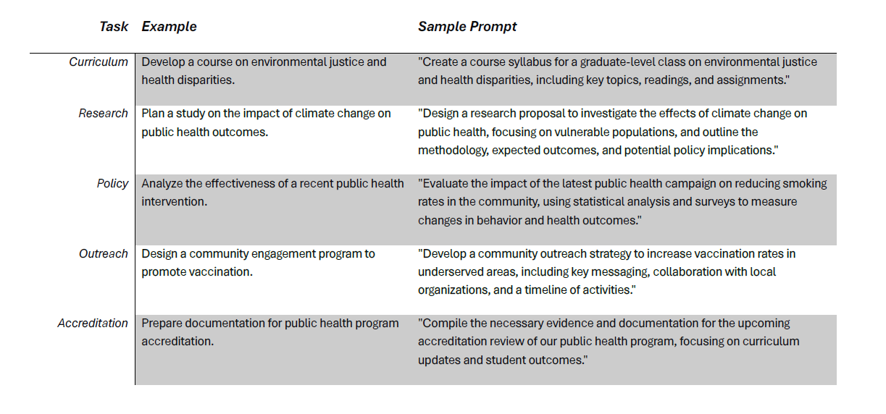

Slide 15
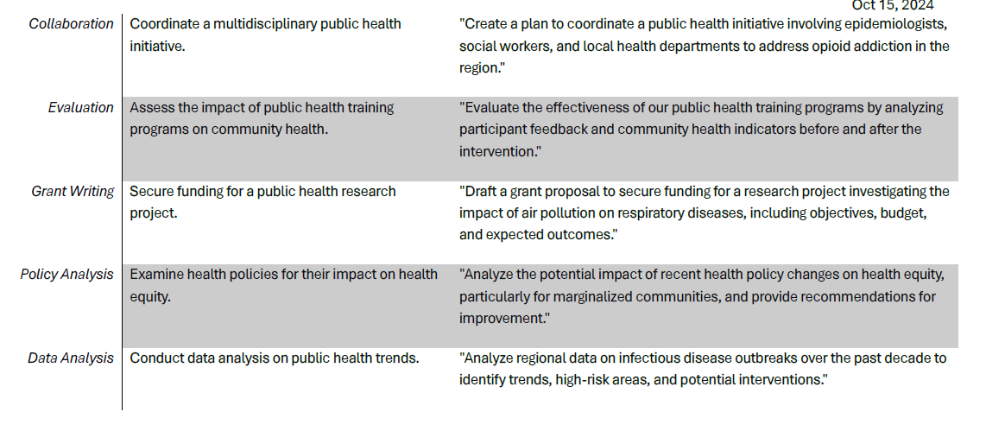

Slide 16
